Slide 1
DSE JAN’2021 GROUP - 6 FINAL REPORT PRESENTATION

Slide 2


TITLE
CONSUMER COMPLAINTS ANALYSIS

Slide 3
TABLE OF CONTENTS
INTRODUCTION
PROBLEM STATEMENT
PREPROCESSING
MODEL BUILDING
CONCLUSION
FUTURE SCOPE

Slide 4
INTRODUCTION
“

Slide 5
INTRODUCTION
The dataset contains real world complaints received about the US financial products and services.
A good complaint-management strategy will result in the best customer relationship outcome with minimal human-resource investment.
To classify future complaints based on its issues, we used different machine learning algorithms to predict more accurately.

Slide 6
REFERENCE
Original owner of data | Consumer Financial Protection Bureau
Data set information | Consumer Complaint Database
Citation | Bureau of Consumer Financial Protection. Consumer Complaint Database. Retrieved Apr 12, 2021 from Kaggle: https://www.kaggle.com/selener/consumer-complaint-database
Link to web page | https://www.kaggle.com/selener/consumer-complaint-database

Slide 7
OBJECTIVES
“

Slide 8
OBJECTIVES
OBJECTIVE 1
OBJECTIVE 2
To predict if there will be any monetary loss from the company side and to emphasize on corresponding areas to save cost associated with the complaint.
To predict if there will be timely responses for the issue, so that respected team can emphasis more on such complaints to resolve it on time.

Slide 9
OBJECTIVE 1

Slide 10
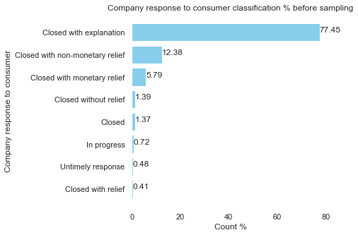
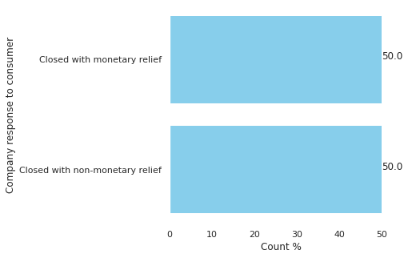
OBJECTIVE 1 DATA SAMPLING
We used Random Under Sampling method to balance the target class.

Slide 11
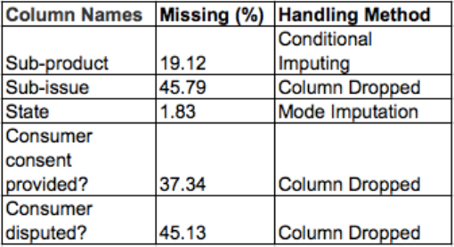
OBJECTIVE 1 MISSING VALUE ANALYSIS

Slide 12
OBJECTIVE 1 PREPROCESSING
Columns | Unique Values
Product | 18
Sub- Product | 75
Issue | 157
Sub issue | 216
Company | 2490
Submitted via | 6
Timely Response | 2
Company response to consumer | 2
Date Received | 1841
Date Sent to company | 1841
State | 62
Consumer Consent Provided | 4
Consumer Disputed | 2
Columns | Unique Values | Feature Engineering
Product | 5 | Removed Redundancy
Sub- Product | 61 | Removed Redundancy
Issue | 78 | Removed Redundancy
Region | 6 | Grouped ‘States’
Company | 2490
Submitted via | 6
Timely Response | 2
Company response to consumer | 2
Duration | Continuous | From Date columns

Slide 13
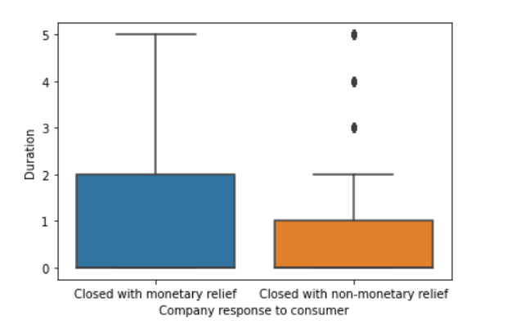
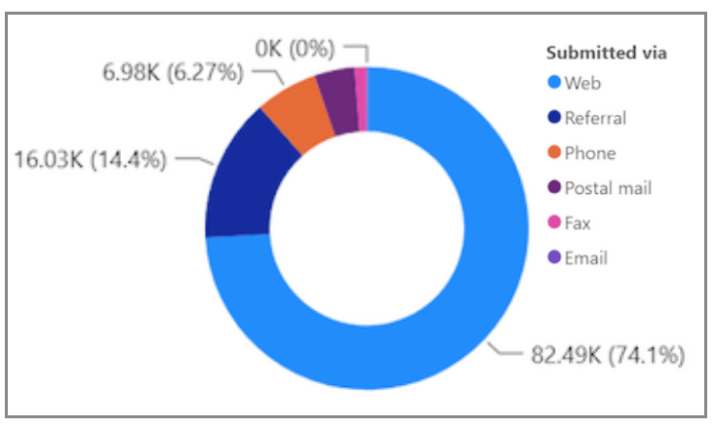
OBJECTIVE 1 EXPLORATORY DATA ANALYSIS

Slide 14
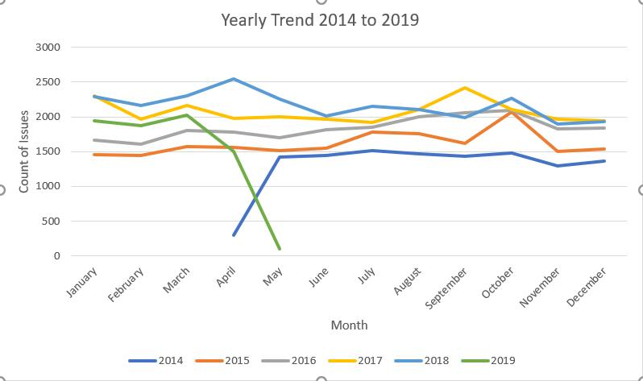
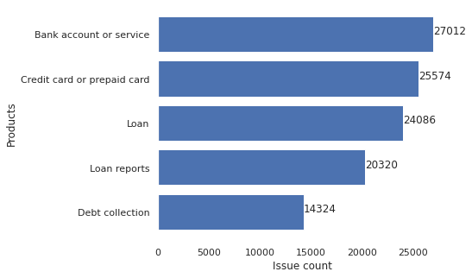
OBJECTIVE 1 EXPLORATORY DATA ANALYSIS

Slide 15
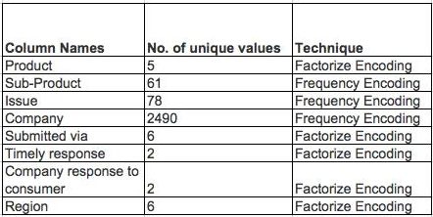
OBJECTIVE 1 ENCODING

Slide 16
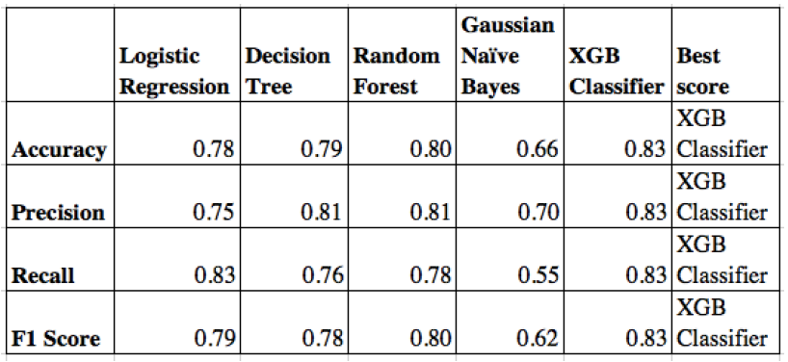
OBJECTIVE 1
MODEL SELECTION

Slide 17
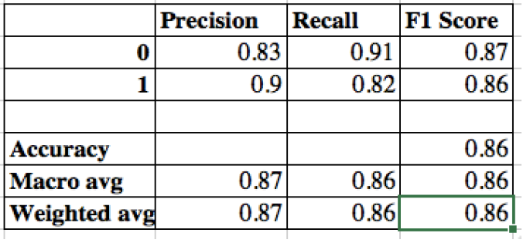
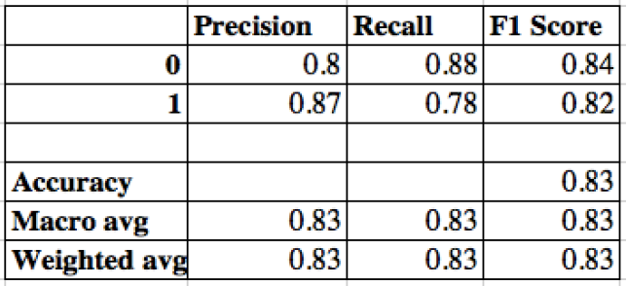
OBJECTIVE 1
BASE MODEL BUILDING
XGB CLASSIFIER PREDICTION
TRAIN DATASET
TEST DATASET

Slide 18
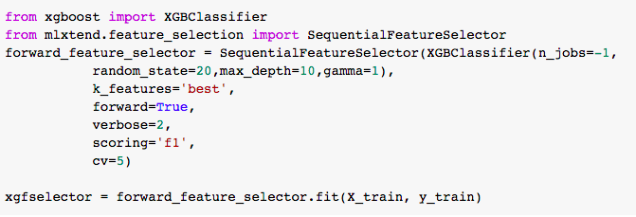
OBJECTIVE 1
FEATURE SELECTION
Important Features :
'Product', 'Sub-product', 'Issue', 'Company', 'Submitted via', 'Timely response?'

Slide 19
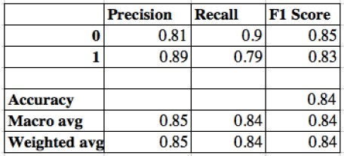
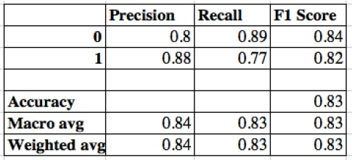
OBJECTIVE 1
HYPER PARAMETER TUNING
GRIDSEARCHCV PREDICTION
TRAIN DATASET
TEST DATASET

Slide 20
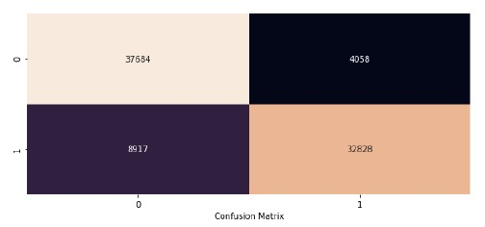
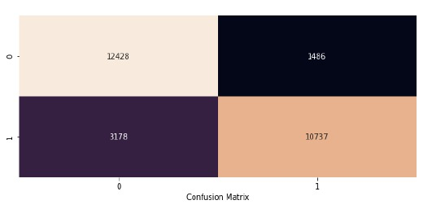
OBJECTIVE 1
HYPER PARAMETER TUNING
TRAIN DATASET
TEST DATASET
0 → Company response with monetary relief
1 → Company response without monetary relief
The alpha error is about 10.6%
The beta error is 22.83%

Slide 21
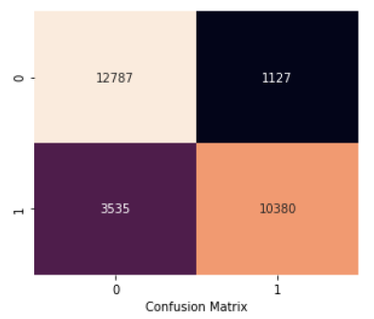
OBJECTIVE 1
THRESHOLD TUNING
CONFUSION MATRIX ON TEST DATASET
In order to reduce the false positives, we adjusted the threshold value to 0.43 to bring about the desired results.
The alpha error is about 8%
The beta error is 25.40%
0 → Company response with monetary relief
1 → Company response without monetary relief

Slide 22
OBJECTIVE 1 BUSINESS INSIGHTS
“Credit card or report card”, the product which encompasses “General purpose card” has more number of issues with monetary reliefs.
“Account opening, Closing or Management” is found to be the cause of major concern among all the issues followed by “Credit report/score” and “Credit card application management”
“Bank of America, National Association” received most number of complaints followed by “Citibank N.A” and “JPMorgan Chase and co”

Slide 23
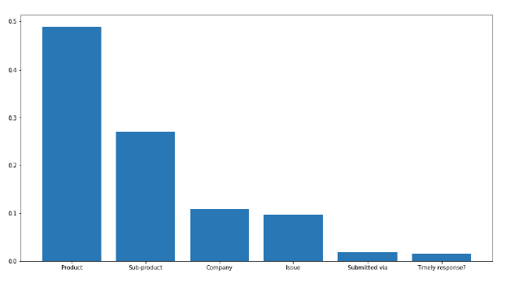
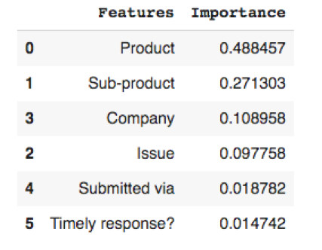
OBJECTIVE 1
FEATURE IMPORTANCE

Slide 24
OBJECTIVE 2

Slide 25
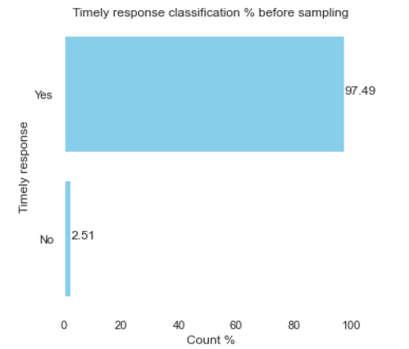
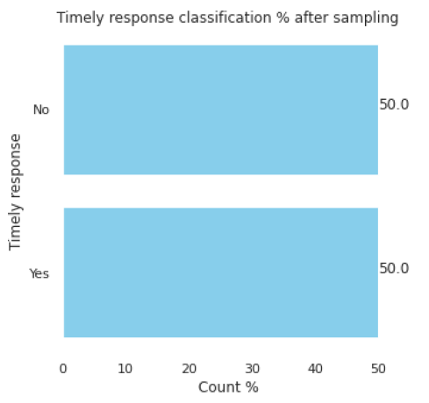
OBJECTIVE 2 DATA SAMPLING
We used Random Under Sampling method to balance the target class.

Slide 26
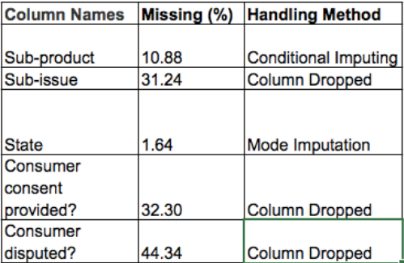
OBJECTIVE 2 MISSING VALUE ANALYSIS

Slide 27
OBJECTIVE 2 PREPROCESSING
Columns | Unique Values
Product | 18
Sub- Product | 74
Issue | 156
Sub issue | 209
Company | 3385
Submitted via | 6
Timely Response | 2
Company response to consumer | 6
Date Received | 1840
Date Sent to company | 1840
State | 61
Consumer Consent Provided | 4
Consumer Disputed | 2
Columns | Unique Values | Feature Engineering
Product | 5 | Removed Redundancy
Sub- Product | 53 | Removed Redundancy
Issue | 94 | Removed Redundancy
Region | 6 | Grouped ‘States’
Company | 3385
Submitted via | 6
Timely Response | 2
Company response to consumer | 6
Duration | Continuous | From Date columns

Slide 28
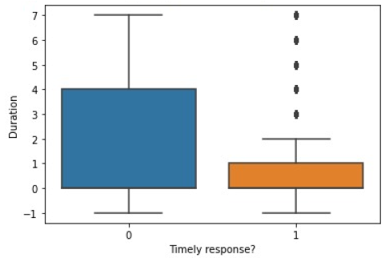
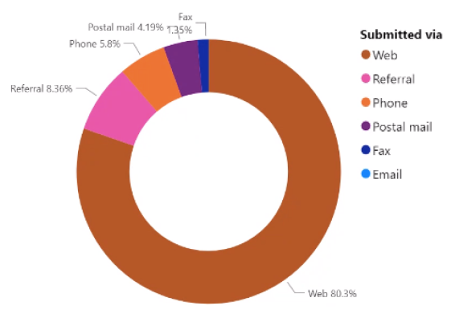
OBJECTIVE 2 EXPLORATORY DATA ANALYSIS

Slide 29
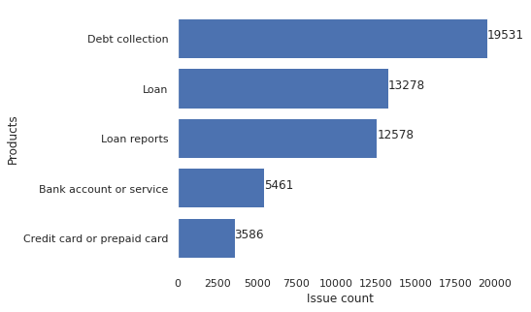
OBJECTIVE 2 EXPLORATORY DATA ANALYSIS

Slide 30
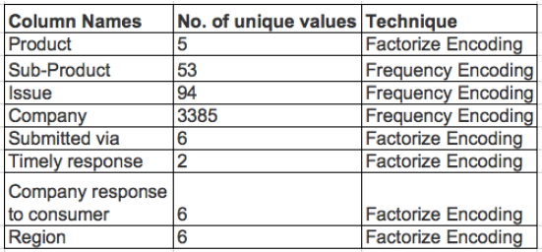
OBJECTIVE 2 ENCODING

Slide 31
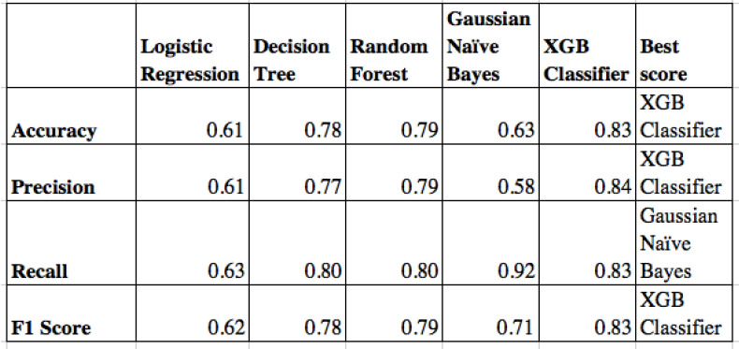
OBJECTIVE 2
MODEL SELECTION

Slide 32
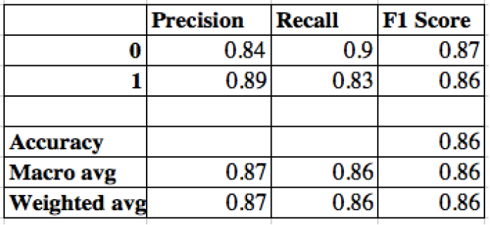
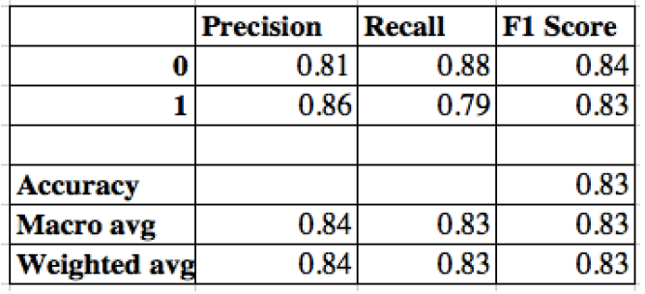
OBJECTIVE 2
BASE MODEL BUILDING
XGB CLASSIFIER PREDICTION
TRAIN DATASET
TEST DATASET

Slide 33
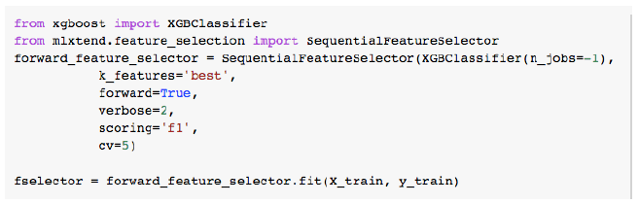
OBJECTIVE 2
FEATURE SELECTION
Important Features :
'Product', 'Sub-product', 'Company' and 'Regions'

Slide 34
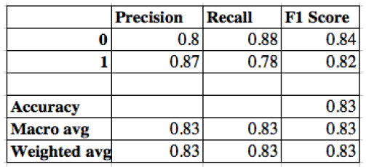
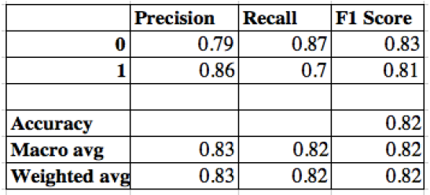
OBJECTIVE 2
HYPER PARAMETER TUNING
GRIDSEARCHCV PREDICTION
TRAIN DATASET
TEST DATASET

Slide 35
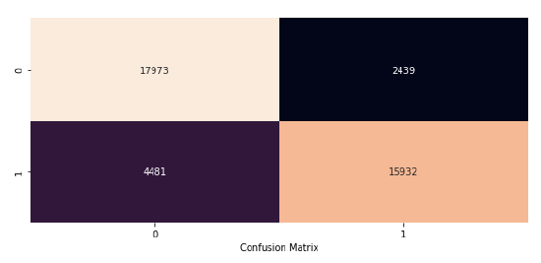
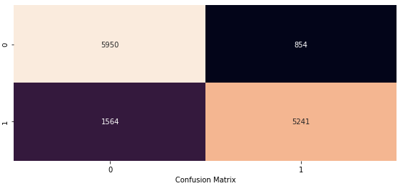
OBJECTIVE 2
HYPER PARAMETER TUNING
TRAIN DATASET
TEST DATASET
0 → Timely Response : No
1 → Timely Response : Yes
The alpha error is about 12.5%
The beta error is 22.9%

Slide 36
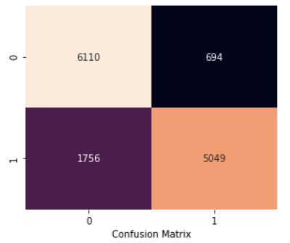
OBJECTIVE 2
THRESHOLD TUNING
CONFUSION MATRIX ON TEST DATASET
In order to reduce the false positives, we adjusted the threshold value to 0.40 to bring about the desired results.
The alpha error is about 10%
The beta error is 25.80%
0 → Timely Response : No
1 → Timely Response : Yes

Slide 37
OBJECTIVE 2 BUSINESS INSIGHTS
“Debt Collection”, the product which encompasses “Other Debt” has more number of issues with no on-time response.
“Debt Collection” has low number of issues closed with monetary relief despite of having higher count of issues.
“Incorrect information on credit report” is found to be the cause of major concern among all the issues followed by “Attempt to collect Debt not owed” and “Disclosures”
“Equifax, Inc” received most number of complaints followed by “Wells fargo and company” and “Experian information solutions Inc.”

Slide 38
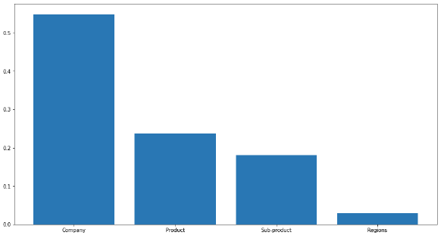
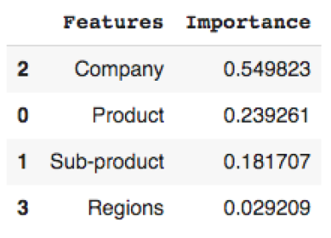
OBJECTIVE 2
FEATURE IMPORTANCE

Slide 39
CONCLUSION & FUTURE SCOPE
“

Slide 40
CONCLUSION
Built the final model after performing hyper parameter tuning to analyze and derive business insights.
Model had an accuracy score of over 80 % for both the objectives.
Our model will help the company to identify issues that require monetary relief. Timely action on the same will reduce the loss.
Allows company to identify the department with most issues, so as to take quick action and to make effective changes.

Slide 41
FUTURE SCOPE
To perform computational linguistic on customer reviews.
To build deep learning classification models for improved accuracy score.
To deploy model and automate the process
The model can be generalized for all the compliant management systems.

Slide 42
THANK YOU
Presented by : Ahilapriya, Divya,
Ganesh & Nivedhan
Mentored by : Mr. Shirude Shashank

